Slide 1
Visualisation in R
Focus on ggplots
Dr Erin I walsh | 10/04/2019

Slide 2
Session overview
The thoughtful figure
Philosophy Key source: Tufte, E., & Graves-Morris, P. (2014). The visual display of quantitative information.; 1983
Base R graphics
The grammar of graphics (aka How I learned to stop worrying and learned to love ggplots)
Grammar Key source: Wilkinson, L. (2006). The grammar of graphics. Springer Science & Business Media. (or the 2010 paper)
Ggplot2 Key source: Elegant graphics for data analysis

Slide 3

Graphics aren’t just for Christmas
Foundation of your data exploration/analysis
Part of communicating with colleagues and yourself (record keeping) as you work on a project
Should be drafted like any other part of the manuscript: iteratively and not an afterthought!

Slide 4
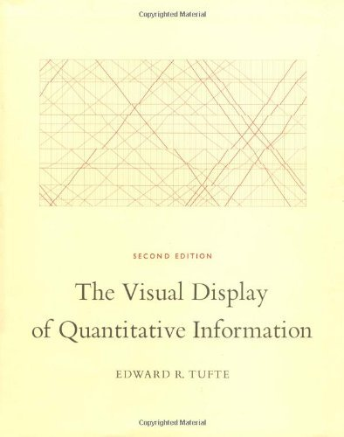
Tufte, E., & Graves-Morris, P. (2014). The visual display of quantitative information.; 1983

Slide 5
Principles of Graphical Excellence
Show the data
Induce the viewer to think about the substance rather than about methodology, graphic design, the technology of the graphic production or something else
Avoid distorting what the data have to say
Present many numbers in a small space
Make large datasets coherent
Encourage the eye to compare different pieces of data
Reveal the data at several levels of detail, from a broad overview to a fine structure
Serve a reasonably clear purpose: description, exploration, tabulation or decoration
Be closely integrated with the statistical verbal descriptions of a dataset

Slide 6
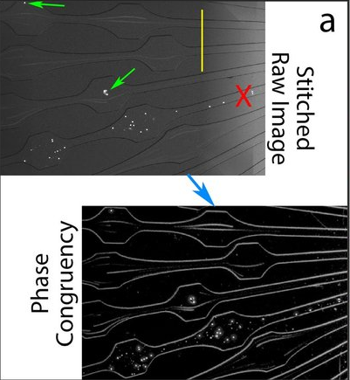
Show the data
Example from: Benson, B. L., Li, L., Myers, J. T., Dorand, R. D., Gurkan, U. A., Huang, A. Y., & Ransohoff, R. M. (2018). Biomimetic post-capillary venule expansions for leukocyte adhesion studies. Scientific Reports, 8(1), 9328.

Slide 7
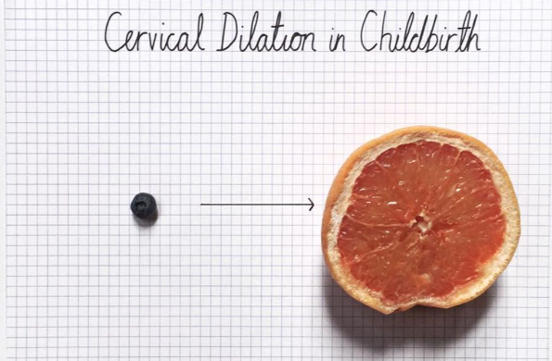
Induce the viewer to think about the substance
Example from: Mona Chalabi from
http://sites.uci.edu/fmd2017fa/files/2017/05/Illustrator-2.pdf

Slide 8
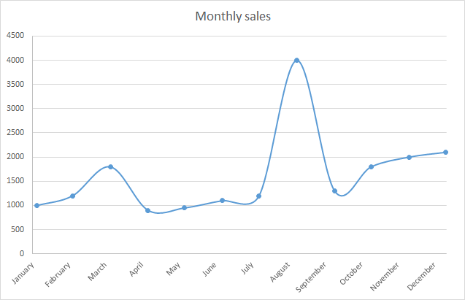
Avoid distorting what the data have to say
Example from: https://m.signalvnoise.com/lets-chart-stop-those-lying-line-charts/

Slide 9
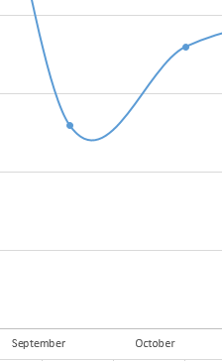
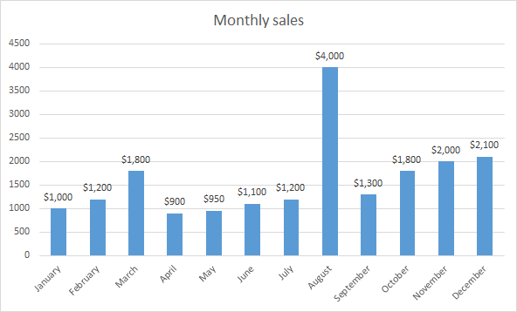
Avoid distorting what the data have to say
Example from: https://m.signalvnoise.com/lets-chart-stop-those-lying-line-charts/

Slide 10
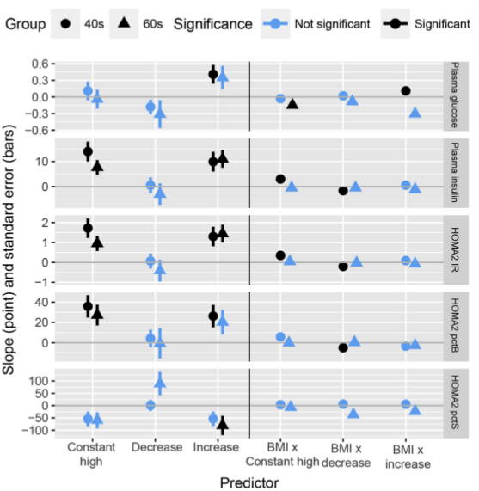
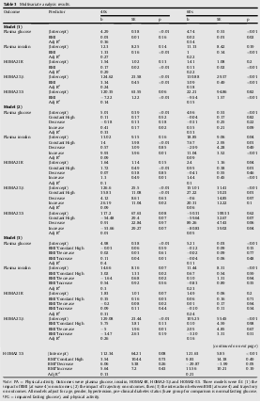
Present many numbers in a small space
Example from: Walsh, E. I., Shaw, J., & Cherbuin, N. (2018). Trajectories of BMI change impact glucose and insulin metabolism. Nutrition, Metabolism and Cardiovascular Diseases, 28(3), 243-251.

Slide 11
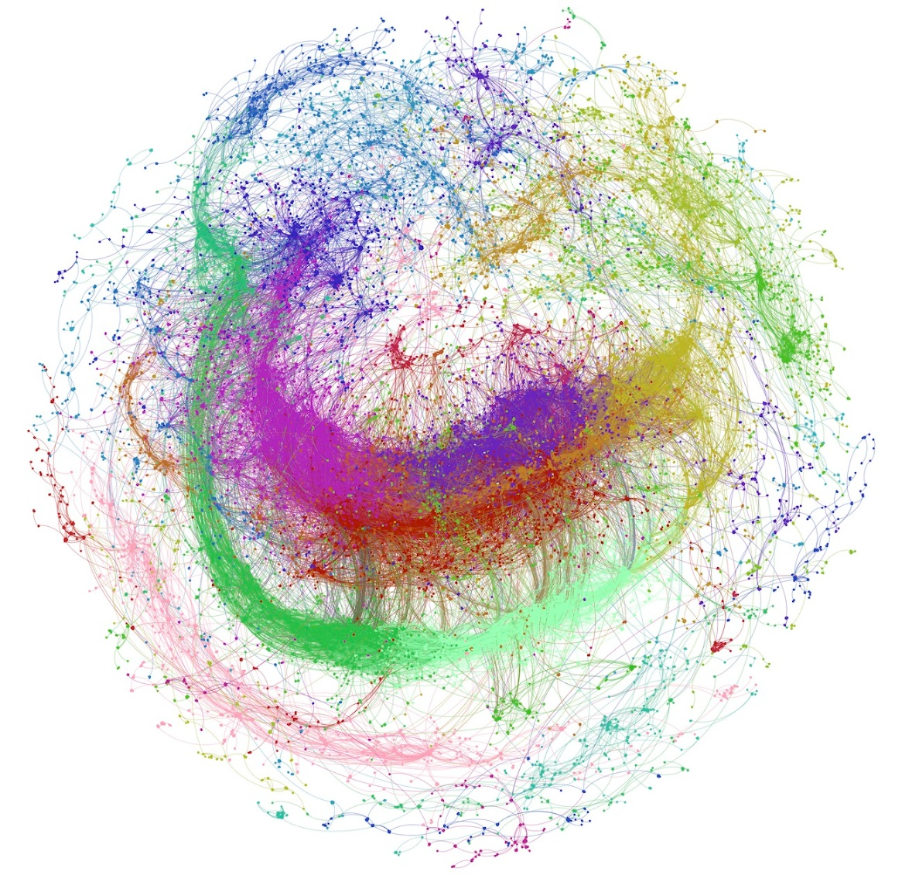
Make large datasets coherent
Example from: GBR coherent patterns from Higgs dataset
https://lts2.epfl.ch/blog/gbr/2015/05/01/principal-patterns-on-graphs-discovering-coherent-structures-in-datasets/
Benzi, K., Ricaud, B., & Vandergheynst, P. (2016). Principal Patterns on Graphs: Discovering Coherent Structures in Datasets. IEEE Trans. Signal and Information Processing over Networks, 2(2), 160-173.

Slide 12
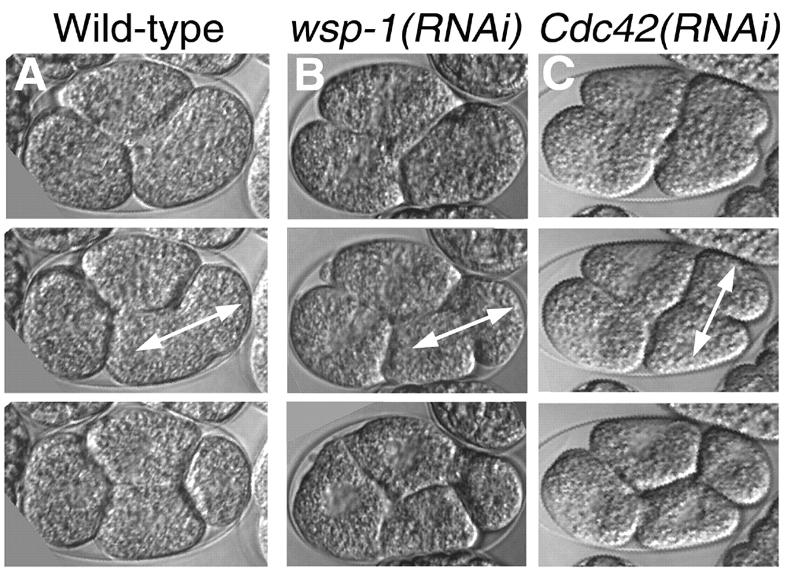
Encourage the eye to compare different pieces of data
Example from: Sawa, M., Suetsugu, S., Sugimoto, A., Miki, H., Yamamoto, M., & Takenawa, T. (2003). Essential role of the C. elegans Arp2/3 complex in cell migration during ventral enclosure. Journal of cell science, 116(8), 1505-1518. http://jcs.biologists.org/content/116/8/1505

Slide 13
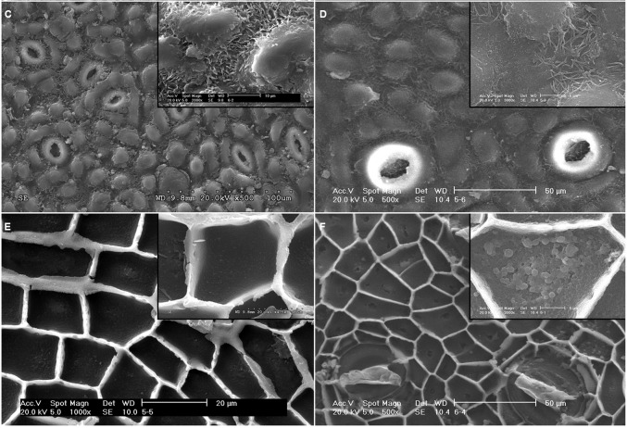
Reveal the data at several levels of detail
Example from: Guzmán, P., Fernández, V., Graça, J., Cabral, V., Kayali, N., Khayet, M., & Gil, L. (2014). Chemical and structural analysis of Eucalyptus globulus and E. camaldulensis leaf cuticles: a lipidized cell wall region. Frontiers in plant science, 5, 481.

Slide 14

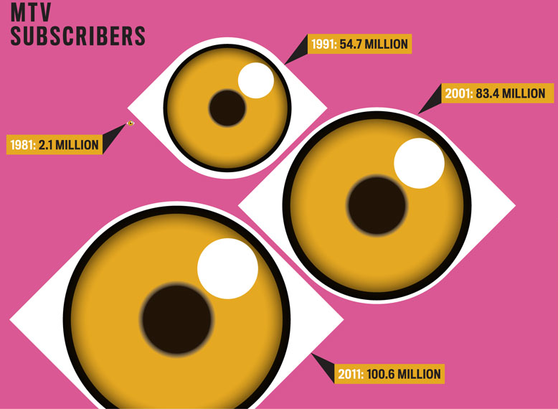
Serve a reasonably clear purpose

Slide 15
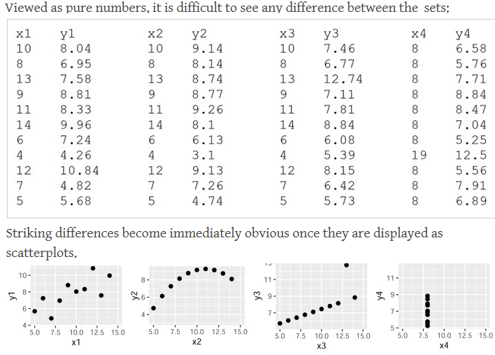
Be closely integrated with the statistical verbal descriptions of a dataset

Slide 16
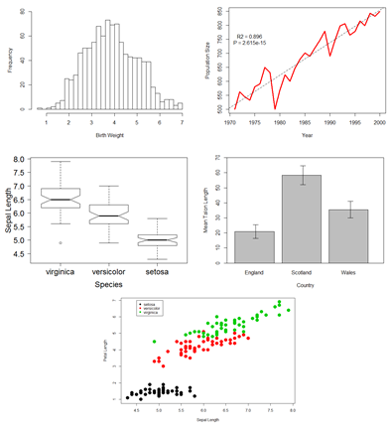
Base R Graphics
Pros:
Quick and simple
Most basic needs implemented
Extremely convenient
Cons:
Unusual plots difficult to create
Not going to win any pageants
(but good if you get stuck on aesthetics when you should be focussing on the next step of analysis).
Recommended usage scenario: Part of initial data exploration and discovery.
Examples from “R Base Graphics: An Idiot’s Guide” by Susan Johnson, http://rpubs.com/SusanEJohnston/7953

Slide 17
Exercise 01 time!
Single variable plots
Histograms
Dot plots
Strip charts
Multiple variable plots
Scatterplots
Paired scatterplots
Boxplots
Output of other functions or operations
Density plots
Linear model diagnostics
Bar plots
Stacked bar plots
Pie charts
Multiple plots
Annotations

Slide 18
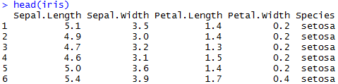
Load the example data
data("iris")
iris$Species<-as.factor(iris$Species)
head(iris)

Slide 19
Single variable plots
Histogram
hist(iris$Sepal.Length)
Dot chart
dotchart(iris$Sepal.Length)
Strip chart
stripchart(iris$Sepal.Length)

Slide 20
Multiple variable plots
Scatterplot
plot(iris$Petal.Length, iris$Petal.Width)
Adding lines to a scatterplot
plot.new()
lines(iris$Petal.Length, iris$Petal.Width)
plot(iris$Petal.Length, iris$Petal.Width)
lines(iris$Petal.Length, iris$Petal.Width)
plot(iris$Petal.Length, iris$Petal.Width, type="l")

Slide 21
Multiple variable plots
Pairs plot
pairs(~iris$Sepal.Length +
iris$Petal.Width +
iris$Sepal.Width)
Box plot
plot(iris$Species, iris$Sepal.Length, type="b")
plot(iris$Species, iris$Sepal.Length, type="b",
notch=TRUE)

Slide 22
Output of other functions or operations
Density plot (cousin of the histogram)
sepal_density<-density(iris$Sepal.Length)
plot(sepal_density)
Linear model diagnostics
sepal_linear<-lm(iris$Sepal.Length ~iris$Petal.Width)
plot(sepal_linear)
Linear model output on points
plot(iris$Sepal.Length ~iris$Petal.Width)
abline(sepal_linear)

Slide 23
Output of other functions or operations
Bar plots
sepal_table<-table(iris$Sepal.Length)
barplot(sepal_table)
barplot(sepal_table,horiz=TRUE)
Stacked bar plots
sepal_table_stacked<-table(iris$Species,
iris$Sepal.Length)
barplot(sepal_table_stacked)
barplot(sepal_table_stacked,
legend = names(table(iris$Species)))
Pie chart
petal_width_bins<-rep("Under 1", length(iris$Petal.Width))
petal_width_bins[which(iris$Petal.Width>1)]<-"Over 1"
petal_width_bins[which(iris$Petal.Width>2)]<-"Over 2"
pie(table(petal_width_bins))

Slide 24
Multiple plots
par(mfrow=c(1,1))
hist(iris$Sepal.Length)
par(mfrow=c(1,2))
hist(iris$Sepal.Length)
hist(iris$Sepal.Length)
par(mfrow=c(2,1))
hist(iris$Sepal.Length)
hist(iris$Sepal.Length)
par(mfrow=c(2,2))
hist(iris$Sepal.Length)
hist(iris$Sepal.Length)
hist(iris$Sepal.Length)
hist(iris$Sepal.Length)
hist(iris$Sepal.Length)
plot(sepal_density)
stripchart(iris$Sepal.Length)
barplot(sepal_table)
par(mfrow=c(1,1))

Slide 25
Annotations
plot(iris$Petal.Length, iris$Petal.Width)
text(1,2.5, labels="Obscured text")
text(1,2, labels="Text adjusted to 0", adj=0)
text(1,1.5, labels="Text adjusted to 0.5", adj=0.5)
text(1,1, labels="Text adjusted to 1", adj=1)
text(5,0.5, labels="Text with different X position")
text(4,2.5, labels="Obscured text")
text(4,2, labels="Text adjusted to 0", adj=0)
text(4,1.5, labels="Text adjusted to 0.5", adj=0.5)
text(4,1, labels="Text adjusted to 1", adj=1)

Slide 26


Slide 27
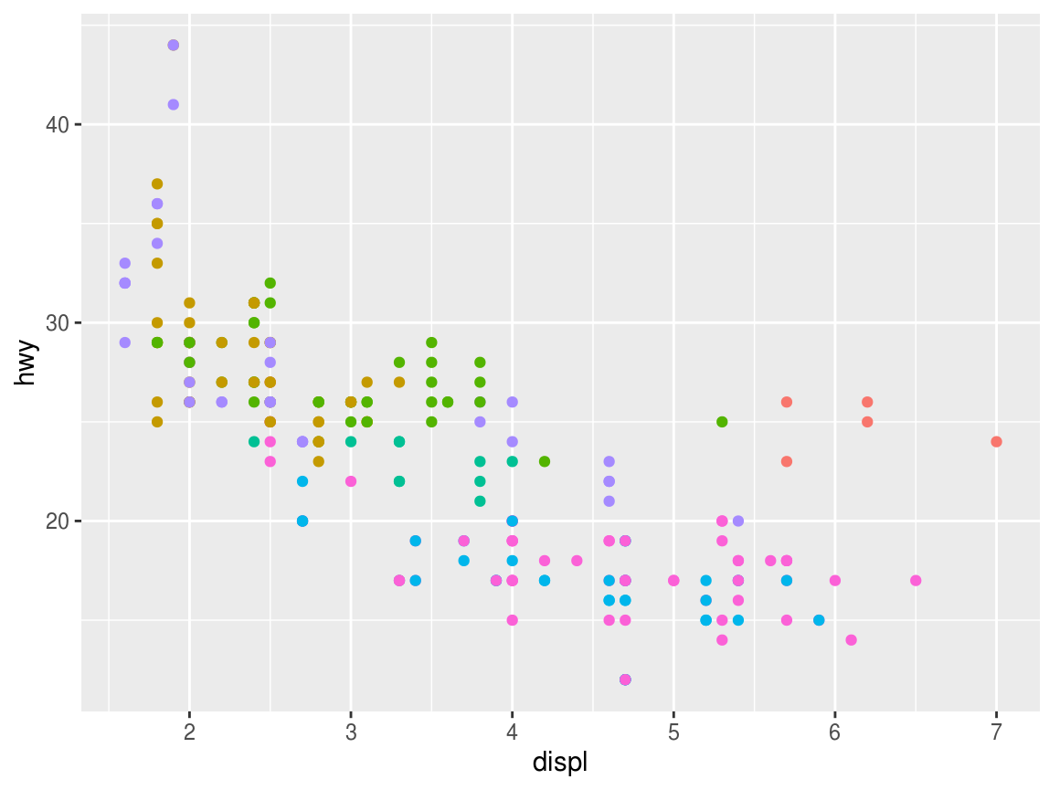

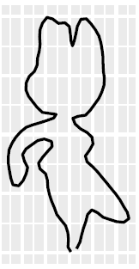
ggplot2
Pros:
Beautiful (some say)
Extensible
Flexible
Cons:
Less convenient
Different logic can lead to unexpected behaviour
Recommended usage scenario: Complex or final data visualisation.
Also fun.

Slide 28
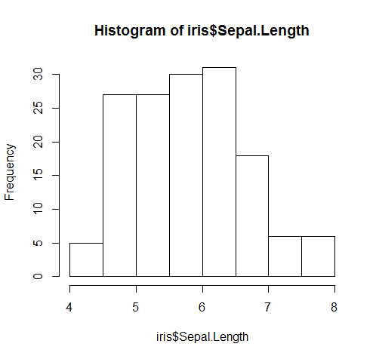
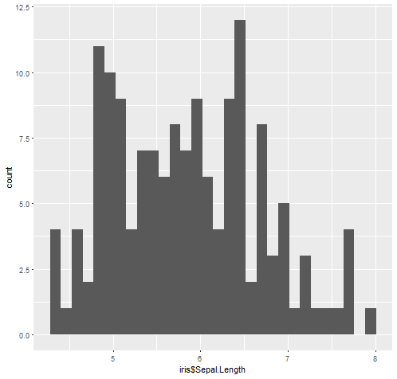
(can be) as easy to use as base r
hist(iris$Sepal.Length)
qplot(iris$Sepal.Length)
Notes:
Quickplot!

Slide 29

Exercise 02
Quick recreations of base R plots in ggplots
Single variable plots
Histograms
Dot plots
Strip charts
Multiple variable plots
Scatterplots
Paired scatterplots
Boxplots
Output of other functions or operations
Density plots
Linear model diagnostics
Bar plots
Stacked bar plots
Pie charts
Multiple plots
Annotations

Slide 30
Single variable plots
Histogram
ggplot(data=iris, aes(x=Sepal.Length)) + geom_histogram()
Dot chart
ggplot(data=iris, aes(x=Sepal.Length)) + geom_dotplot()
Strip chart
- No base ggplot version of a strip chart

Slide 31
Multiple variable plots
Scatterplot
ggplot(data=iris, aes(x=Petal.Length, y=Petal.Width)) + geom_point()
Adding lines to a scatterplot
ggplot(data=iris, aes(x=Petal.Length, y=Petal.Width)) + geom_line()
Pairs plot
library(GGally)
ggpairs(iris[,c("Sepal.Length","Petal.Width","Sepal.Width")])
Box plot
ggplot(data=iris, aes(x=Species, y=Sepal.Length)) + geom_boxplot()

Slide 32
Output of other functions or operations
Density plot (cousin of the histogram)
ggplot(data=iris, aes(x=Sepal.Length)) + geom_density()
Linear model diagnostics
No base ggplot version of linear model diagnostics
Linear model output on points
ggplot(data=iris, aes(x=Sepal.Length, y=Petal.Width)) +
geom_point() + geom_smooth(method="lm")
Bar plots
ggplot(data=iris, aes(x=Sepal.Length)) + geom_bar()
Stacked bar plots
ggplot(data=iris, aes(x=Sepal.Length)) +
geom_bar(aes(fill=Species))
Pie chart
ggplot(iris, aes(x="", y=Petal.Width, fill=Species))+
geom_bar(width = 1, stat = "identity") +
coord_polar("y", start=0)

Slide 33
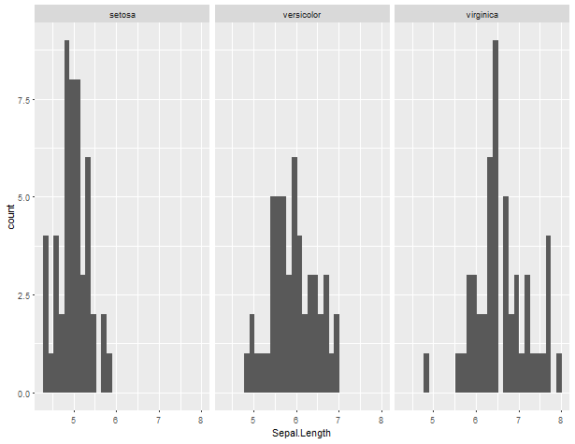
Multiple plots
ggplot(data=iris, aes(x=Sepal.Length)) +
geom_histogram() + facet_wrap(~Species)

Slide 34
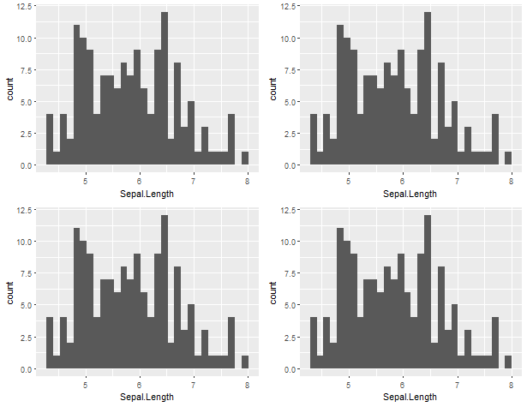
Multiple plots
ggplot(data=iris, aes(x=Sepal.Length)) +
geom_histogram() + facet_wrap(~Species)
library(gridExtra)
grid.arrange(plot_1, plot_2, plot_3, plot_4)

Slide 35
Multiple plots
Facets
ggplot(data=iris, aes(x=Sepal.Length)) + geom_histogram() +
facet_wrap(~Species)
Works across almost all plot types
ggplot(data=iris, aes(x=Petal.Length, y=Petal.Width)) +
geom_point() + facet_wrap(~Species)
Still works, even if it is redundant.
ggplot(data=iris, aes(x=Species, y=Sepal.Length)) +
geom_boxplot()+ facet_wrap(~Species)
ggplot(data=iris, aes(x=Sepal.Length)) +
geom_bar(aes(fill=Species))+ facet_wrap(~Species)

Slide 36
Multiple plots
gridExtra
library(gridExtra)
grid.arrange(ggplot(data=iris, aes(x=Sepal.Length)) + geom_histogram(),
ggplot(data=iris, aes(x=Sepal.Length)) + geom_histogram(),
ggplot(data=iris, aes(x=Sepal.Length)) + geom_histogram(),
ggplot(data=iris, aes(x=Sepal.Length)) + geom_histogram())
This gives extra flexibility, e.g. specifying rows and columns
grid.arrange(nrow=1,
ggplot(data=iris, aes(x=Sepal.Length)) + geom_histogram(),
ggplot(data=iris, aes(x=Sepal.Length)) + geom_histogram(),
ggplot(data=iris, aes(x=Sepal.Length)) + geom_histogram(),
ggplot(data=iris, aes(x=Sepal.Length)) + geom_histogram())
grid.arrange(ncol=1,
ggplot(data=iris, aes(x=Sepal.Length)) + geom_histogram(),
ggplot(data=iris, aes(x=Sepal.Length)) + geom_histogram(),
ggplot(data=iris, aes(x=Sepal.Length)) + geom_histogram(),
ggplot(data=iris, aes(x=Sepal.Length)) + geom_histogram())

Slide 37
Multiple plots
gridExtra
Nesting can be done conveniently via Grobs:
grid.arrange(ggplot(data=iris, aes(x=Sepal.Length)) + geom_histogram(),
arrangeGrob(nrow=1,
ggplot(data=iris, aes(x=Sepal.Length)) + geom_histogram(),
ggplot(data=iris, aes(x=Sepal.Length)) + geom_histogram(),
ggplot(data=iris, aes(x=Sepal.Length)) + geom_histogram()))
The major title is easily added
grid.arrange(top ="This is a title",
ggplot(data=iris, aes(x=Sepal.Length)) + geom_histogram(),
arrangeGrob(nrow=1,
ggplot(data=iris, aes(x=Sepal.Length)) + geom_histogram(),
ggplot(data=iris, aes(x=Sepal.Length)) + geom_histogram(),
ggplot(data=iris, aes(x=Sepal.Length)) + geom_histogram())
)
Both plots and grobs can be saved as objects
plot_object<-ggplot(data=iris, aes(x=Sepal.Length)) + geom_histogram()
grob_object<- arrangeGrob(nrow=1,
ggplot(data=iris, aes(x=Sepal.Length)) + geom_histogram(),
ggplot(data=iris, aes(x=Sepal.Length)) + geom_histogram(),
ggplot(data=iris, aes(x=Sepal.Length)) + geom_histogram())
grid.arrange(plot_object,grob_object)

Slide 38
Multiple plots
gridExtra
Used in combination with functions and loops,
this is EXTREMELY convenient for iterative plotting.
iterative_plot<-list()
for(i in 1:10){iterative_plot[[i]]<-ggplot(data=iris[sample(nrow(iris), 15), ],
aes(x=Petal.Length, y=Petal.Width)) + geom_point()}
do.call(grid.arrange, iterative_plot)
do.call(grid.arrange, iterative_plot[1:4])
do.call(grid.arrange, c(iterative_plot[1:4], top="Title"))

Slide 39
Annotations
ggplot(data=iris, aes(x=Petal.Length, y=Petal.Width)) + geom_point() + geom_text(aes(x=5, y=0.5,label="Text"))

Slide 40
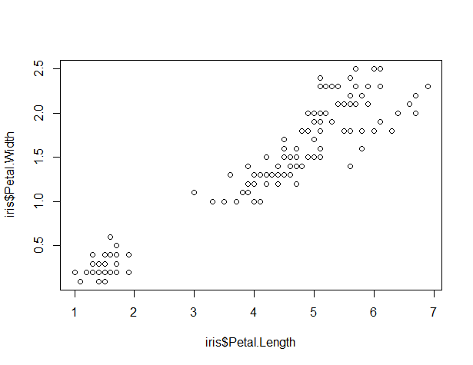
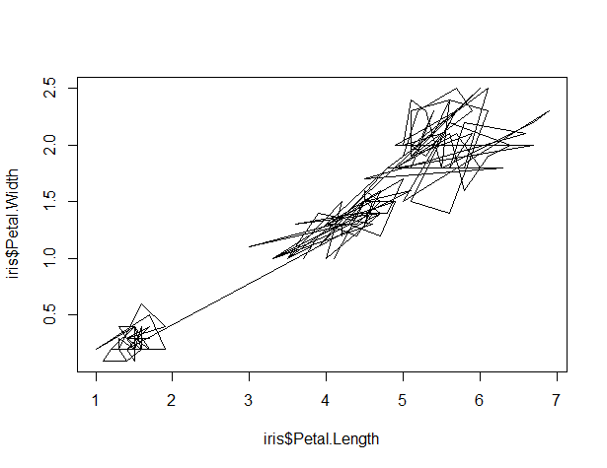
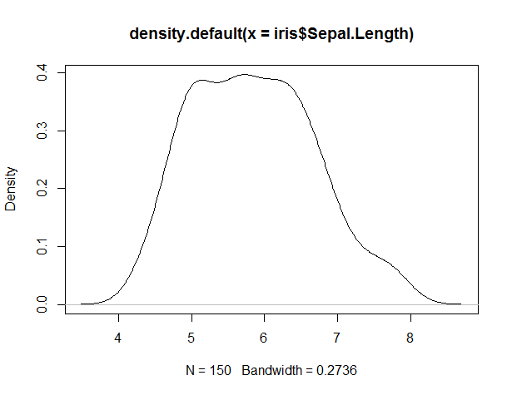
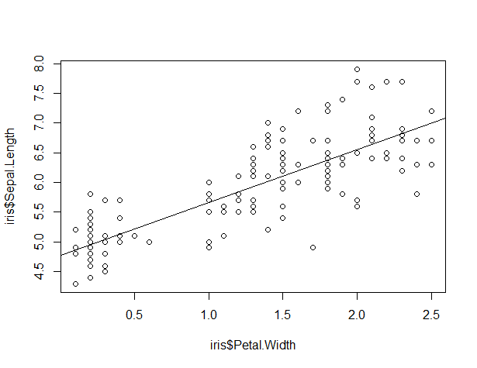
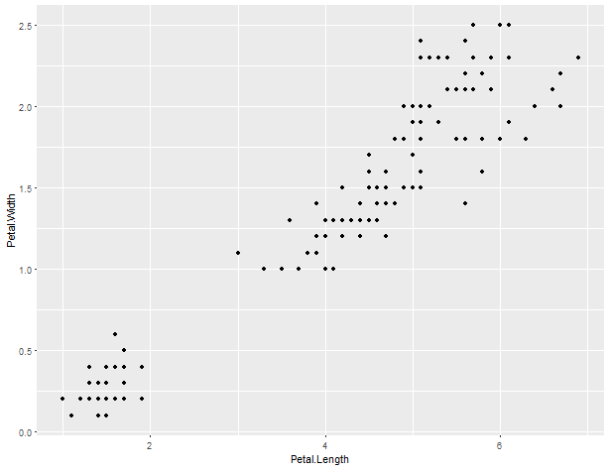
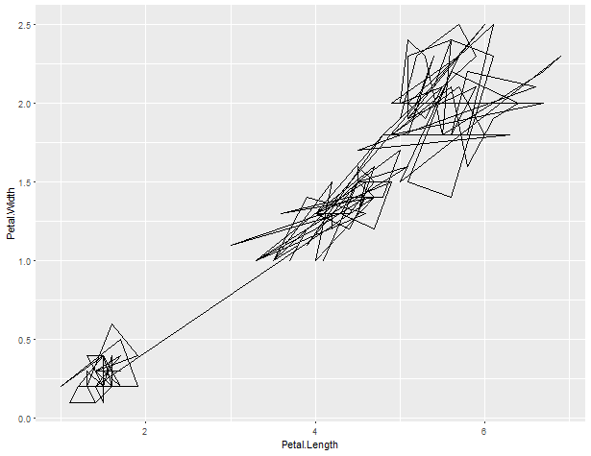
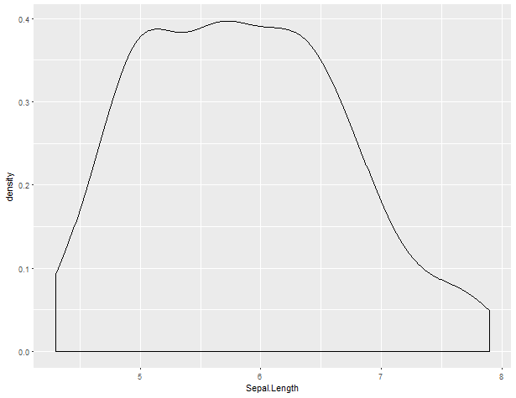
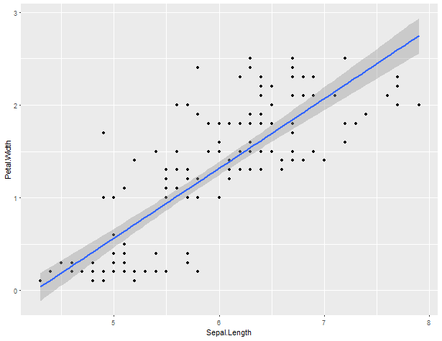
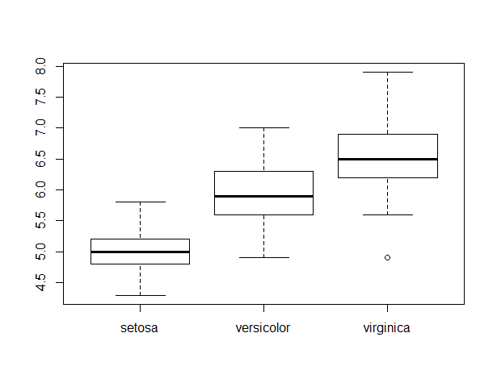
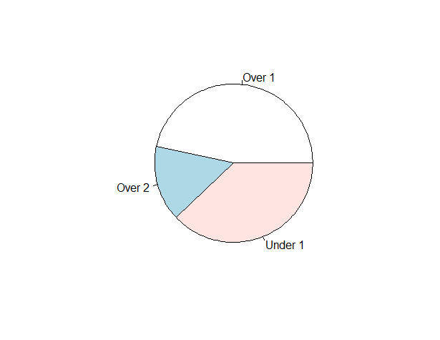
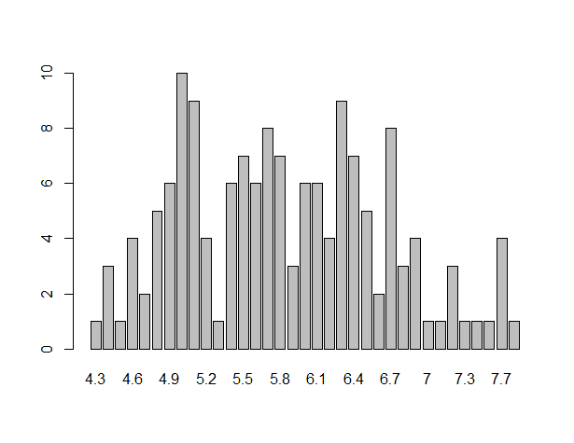
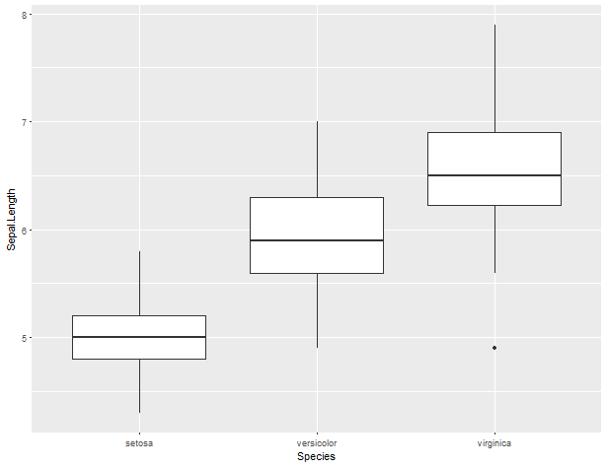
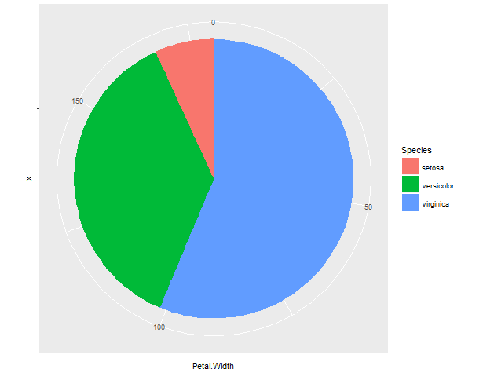
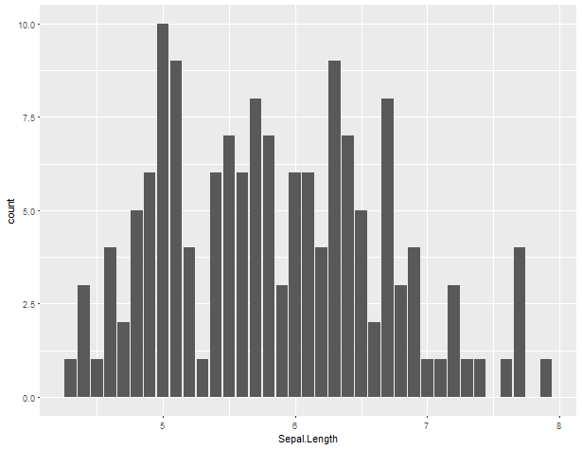
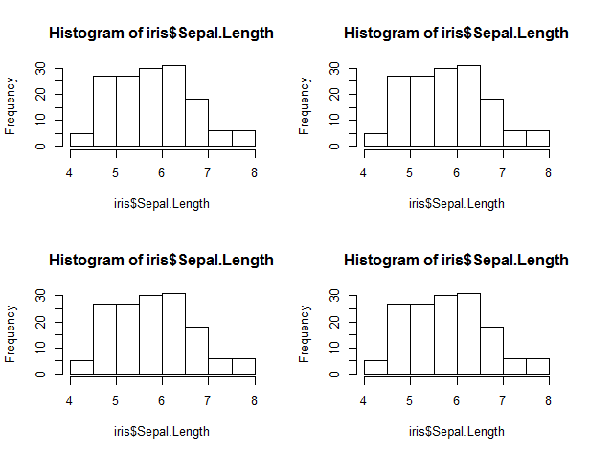
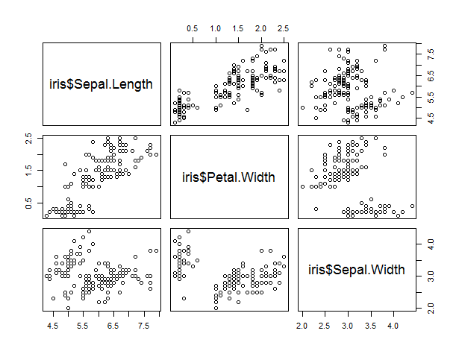
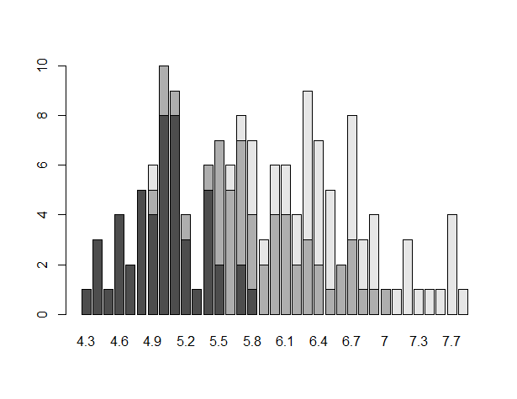
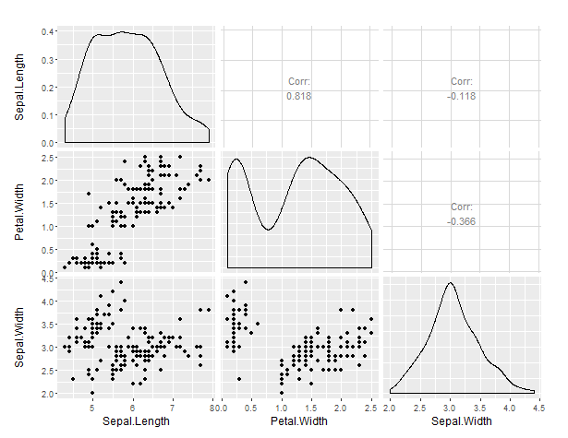
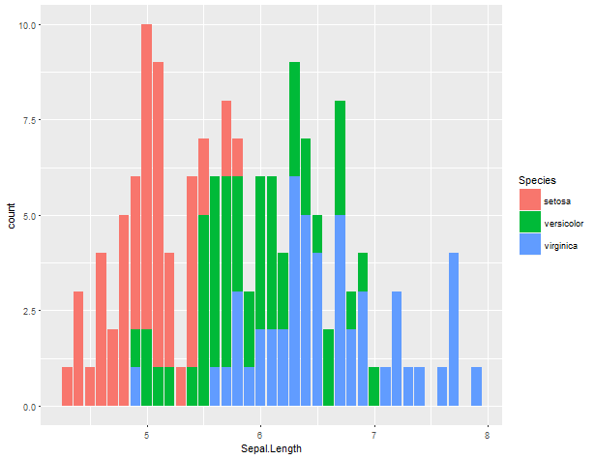

Slide 41

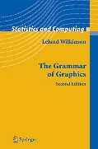

Slide 42
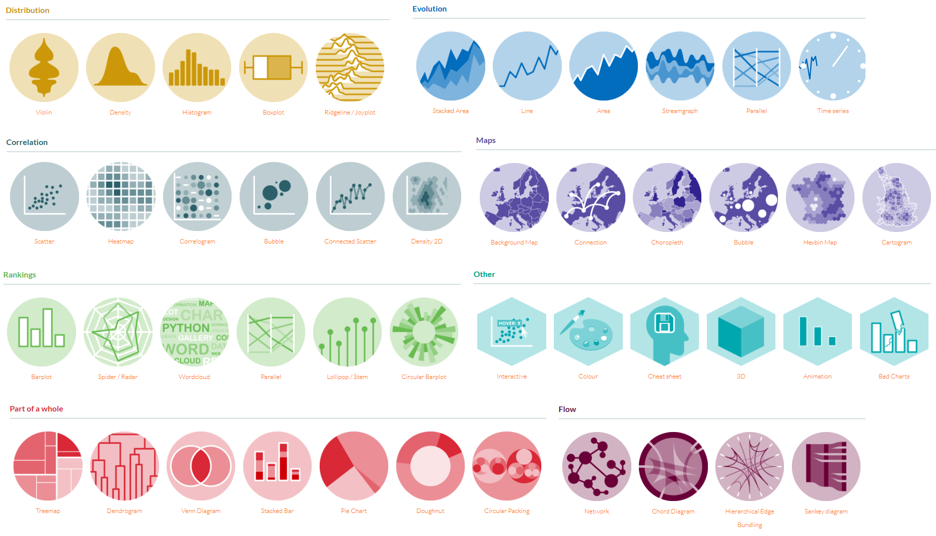
Examples from https://www.r-graph-gallery.com/
Notes:
Too many things to cover all at once – instead will cover the underlying logic.

Slide 43

Wilkinson, L. (2006). The grammar of graphics. Springer Science & Business Media.

Slide 44
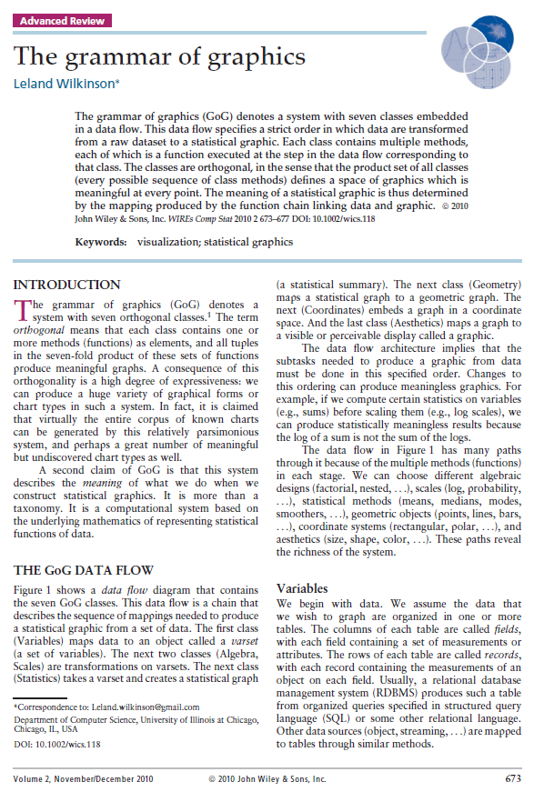
Wilkinson, L. (2006). The grammar of graphics. Springer Science & Business Media.
DOI: 10.1002/wics.118

Slide 45


Slide 46

Exercise 03
Follow along, with the iris dataset, looking at Sepal.Length and Petal.Width

Slide 47
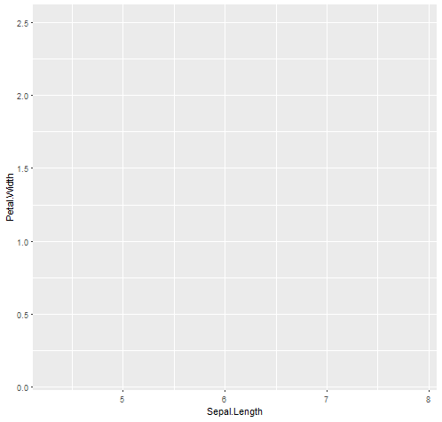
ggplot(data=dataset, aes(x=var, y=var2, …))
Notes:
Start with a blank plot. This is the only part that needs to be done first; the order of the rest can vary.

Slide 48
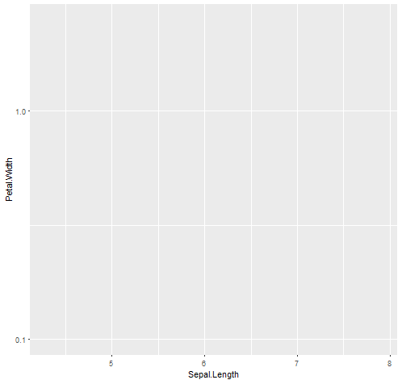
ggplot(data=dataset, aes(x=var, y=var2, …)) +
scale_y_log10()

Slide 49
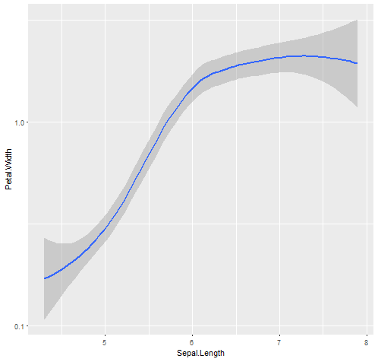
ggplot(data=dataset, aes(x=var, y=var2, …)) +
scale_y_log10() +
geom_smooth()

Slide 50

ggplot(data=dataset, aes(x=var, y=var2, …)) +
scale_y_log10() +
geom_smooth() +
geom_point() +

Slide 51
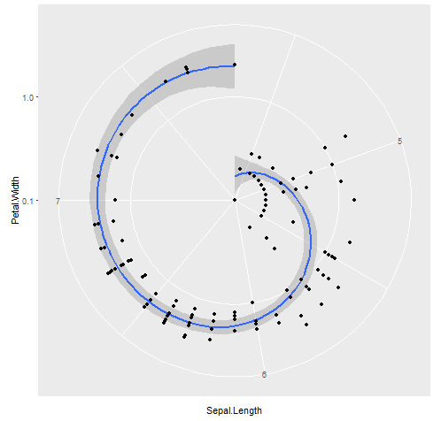
ggplot(data=dataset, aes(x=var, y=var2, …)) +
scale_y_log10() +
geom_smooth() +
geom_point() +
coord_polar()

Slide 52
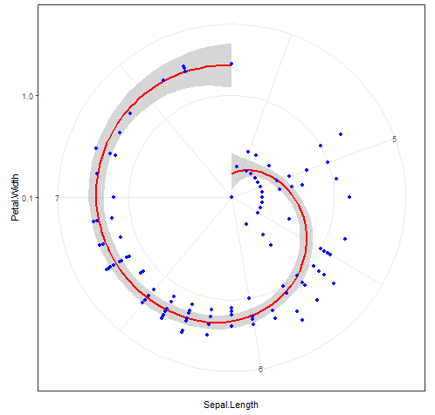
ggplot(data=dataset, aes(x=var, y=var2, …)) +
scale_y_log10() +
geom_smooth(colour=“red”) +
geom_point(colour=yellow) +
coord_polar() +
theme_bw()

Slide 53

Image source: https://cityofbyroncity.files.wordpress.com/2012/03/puppy-pics32.jpg

Slide 54
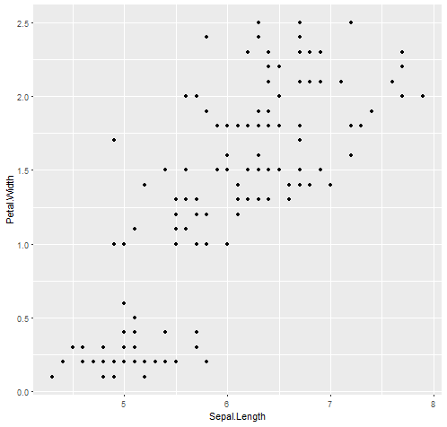
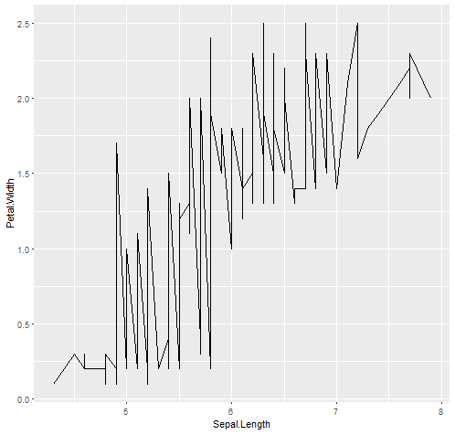
ggplots are built up in layers
base_plot<-ggplot(data=dataset, aes(x=var, y=var2, …))
point_plot<-base_plot + geom_point()
line_plot<-base_plot + geom_line()

Slide 55

Each step of the grammar can be saved as variables and added together.
base_plot + geom_point()
base_plot + geom_point() + geom_line()

Slide 56
But you can’t just add two finished plots.
point_plot + line_plot
Error: Don't know how to add o to a plot
both_plot<-base_plot + geom_point() + geom_line()

Slide 57
General procedure
Make your empty plot with ggplot() function
This is the point where you specify the data and variables
Add the actual information with geom()
You can add multiple layers of data in multiple geoms
Tweak the axes with scales()
Choose the projection with coords()
Mostly you skip this step
Play with the aesthetic within previous steps and use themes()

Slide 58
Exercise 04: the plot thickens
Go through each step and explore in the Iris data…
Then build your own plots out of your own data

Slide 59




base_cont<-ggplot(data=iris, aes(x=Sepal.Length))
base_cont_cont<-ggplot(data=iris, aes(x=Sepal.Length, y=Petal.Width))
base_cont_cat<-ggplot(data=iris, aes(x=Species, y=Petal.Width))
square<-data.frame(x=c(1,2,2,1,1),
y=c(2,2,1,1,2))
base_cont_shape<-ggplot(data=square,
aes(x=x, y=y))
Notes:
Follow along: make one of each of the most common variable combinations for plotting

Slide 60
Geoms for single continuous variables
geom_bar()
geom_histogram()
geom_density()
geom_freqpoly()
Try each one with base_cont
Further references: http://sape.inf.usi.ch/quick-reference/ggplot2/geom
Notes:
Try each one with

Slide 61
Geoms for continuous by continuous variables
geom_point()
geom_jitter()
geom_line()
geom_rug()
geom_step()
geom_tile()
geom_bin2d()
geom_hex()
geom_quantile()
geom_smooth()
Try each one with base_cont_cont
Further references: http://sape.inf.usi.ch/quick-reference/ggplot2/geom

Slide 62
Geoms for continuous by categorical variables
geom_boxplot()
geom_boxplot() + geom_jitter()
Try with base_cont_cat
Further references: http://sape.inf.usi.ch/quick-reference/ggplot2/geom

Slide 63
Geoms for shapes
geom_path()
geom_polygon()
geom_area()
Try each one with base_cont_shape
Further references: http://sape.inf.usi.ch/quick-reference/ggplot2/geom

Slide 64
Geoms for error bars
Ggplots doesn’t do this for you, so you need to prepare the data first…
e.g. for error bars reflecting standard deviations by group:
summary_grabber<-function(x,group){data.frame(species=group,
Sepal.Length=mean(iris[which(iris$Species==group),x]),
sd=sd(iris[which(iris$Species==group),x]))}
se_dat<-rbind(summary_grabber("Sepal.Length","setosa"),
summary_grabber("Sepal.Length","versicolor"),
summary_grabber("Sepal.Length","virginica"))
se_dat$sd_lower<-se_dat$Sepal.Length-se_dat$sd
se_dat$sd_upper<-se_dat$Sepal.Length+se_dat$sd

Slide 65



Geoms for error bars
bar_base <-ggplot(data=se_dat,
aes(x=species,
y=Sepal.Length)) +
geom_bar(stat="identity")
bar_base +
geom_errorbar(ymin=se_dat$sd_lower,
ymax=se_dat$sd_upper)

Slide 66
Geoms for error bars
geom_errorbar()
geom_linerange()
geom_pointrange()
geom_crossbar()
Note: geom_errorbarh() works the same as geom_errorbar() but for the x axis
Try each one with bar_base

Slide 67
Scales and axes
Reverse the axes: scale_x_reverse() and scale_y_reverse()
Transform the axes:
At the point of plotting:
ggplot(data=dataset, aes(x=log10(var), y=scale(var2))) + geom_point()
After plotting:
scale_x_log10() and scale_y_log10()
scale_x_sqrt() and scale_y_sqrt()
coord_trans(x=“log10”, y=“sqrt”)

Slide 68



Coords
Change the projection
coord_flip() – reverse x and y axes
coord_equal() – fix aspect ratio, like asp(TRUE) in base R
coord_polar() – polar coordinates
Also coord_map() for map projections and coord_cartesian(), which is just the default.
Try each one!

Slide 69
Adding and changing text
For the plot area, use a geom:
geom_text(label=“text”, x=xpos,y=ypos)
Try each of these steps with bar_base:
geom_text(label="hello")
geom_text(label="hello", x=1)
geom_text(label="hello", x=1,y=1)
geom_text(label="hello", x=1,y=1, colour="white")
The title has its own segment;
ggtitle("Title text goes here")
Changing axis labels is similar:
xlab("X axis label")
ylab("Y axis label")
Try to give bar_base a unique title and axis labels.

Slide 70


Themes
Many existing themes
theme_grey() (default)
theme_bw()
theme_linedraw()
theme_light()
theme_dark()
theme_minimal()
theme_classic()
theme_void()
Try each one!

Slide 71
Themes
You can make your own, save it as a variable you can add on. Here’s just one example to play with:
custom_theme <- theme(
plot.title = element_text(color = "blue",
face = "bold", size=rel(2)),
panel.grid.major = element_line(colour="red",
linetype = "dotted"),
panel.background = element_rect(fill = "yellow")
)
point_plot + ggtitle("Your own theme") + custom_theme
Further education:
https://bookdown.org/rdpeng/RProgDA/building-a-new-theme.html

Slide 72
Themes
You can make your own, save it as a variable you can add on. Here’s just one example to play with:
custom_theme <- theme(
plot.title = element_text(color = "blue",
face = "bold", size=rel(2)),
panel.grid.major = element_line(colour="red",
linetype = "dotted"),
panel.background = element_rect(fill = "yellow")
)
point_plot + ggtitle("Your own theme") + custom_theme
Further education:
https://bookdown.org/rdpeng/RProgDA/building-a-new-theme.html

Slide 73
Themes
You can make your own, save it as a variable you can add on. Here’s just one example to play with:
custom_theme <- theme(
plot.title = element_text(color = "blue",
face = "bold", size=rel(2)),
panel.grid.major = element_line(colour="red",
linetype = "dotted"),
panel.background = element_rect(fill = "yellow")
)
point_plot + ggtitle("Your own theme") + custom_theme
Further education:
https://bookdown.org/rdpeng/RProgDA/building-a-new-theme.html

Slide 74




















geoms
scales and axes
scale_y_log()
coords
coord_equal()
Adding and changing text
geom_text()
Themes
Theme_bw()

Slide 75

Recommended reading
Tufte, E., & Graves-Morris, P. (2014). The visual display of quantitative information.; 1983
Johnston, S. (2014) R Base graphics: an Idiot’s guide http://rpubs.com/SusanEJohnston/7953
Wilkinson, L. (2007) The grammar of graphics. Journal of statistical software 17(3). doi: 10.1002/wics.118
Wickham, H. (2016). ggplot2: elegant graphics for data analysis. Springer. (ANU library has one copy)

Slide 76


Slide 77
Bonus slides: the grammar of graphics

Slide 78

Variable = each piece of data we wish to visualise
(Varset is a set of one or more variables)

Slide 79



Variable = each piece of data we wish to visualise
(Varset is a set of one or more variables)
Algebra = combining the varset together.

Slide 80

Variable = each piece of data we wish to visualise
(Varset is a set of one or more variables)
Algebra = combining the varset together.
Scales = identifying whether it is nominal, ordinal, interval, or ratio (because each one should be plotted differently)
Fun Tip: The order in the factor will be the order in the plot: to change the order in the plot, change the order of the factor AT THIS POINT.
Ratio
(continuous)
Ratio
(continuous)
Ordinal
(categorical)
Notes:
allows it to fit intelligently on the screen

Slide 81



Variable = each piece of data we wish to visualise
(Varset is a set of one or more variables)
Algebra = combining the varset together.
Scales = identifying whether it is nominal, ordinal, interval, or ratio (because each one should be plotted differently)
Statistics = receives a varset, computes statistical summaries, and outputs another varset (e.g. means, medians, correlations…)
Fun Tip: For most statistics, you can do this manually beforehand, or let ggplot do it for you.

Slide 82

Variable = each piece of data we wish to visualise
(Varset is a set of one or more variables)
Algebra = combining the varset together.
Scales = identifying whether it is nominal, ordinal, interval, or ratio (because each one should be plotted differently)
Statistics = receives a varset, computes statistical summaries, and outputs another varset (e.g. means, medians, correlations…)
Geometry = graphing functions injectively map an m-dimensional bounded region to an n-dimensional real space
AKA the extent of the plot
Fun Tip: ggplot plots the data AFTER this. So if you manually change the axes, you change the plot fundamentally (not just plotting everything and shrinking the window down).

Slide 83

Variable = each piece of data we wish to visualise
(Varset is a set of one or more variables)
Algebra = combining the varset together.
Scales = identifying whether it is nominal, ordinal, interval, or ratio (because each one should be plotted differently)
Statistics = receives a varset, computes statistical summaries, and outputs another varset (e.g. means, medians, correlations…)
Geometry = graphing functions injectively map an m-dimensional bounded region to an n-dimensional real space
Coordinates = Cartesian coordinates. ‘nuff said.
Image source: https://naiadseye.files.wordpress.com/2014/10/euclidean-udnerstand-e1414490051530.png?w=470&h=289
Notes:
Cartesian coords = grid. Could also be polar etc – like map proje

Slide 84


Variable = each piece of data we wish to visualise
(Varset is a set of one or more variables)
Algebra = combining the varset together.
Scales = identifying whether it is nominal, ordinal, interval, or ratio (because each one should be plotted differently)
Statistics = receives a varset, computes statistical summaries, and outputs another varset (e.g. means, medians, correlations…)
Geometry = graphing functions injectively map an m-dimensional bounded region to an n-dimensional real space
Coordinates = Cartesian coordinates. ‘nuff said.
Aesthetics = colours, size, shapes,

Slide 85
… But every step is customisable!

